Slide 1
JAVA Advanced
SAMAR MANSOUR

Slide 2
Concepts
Cookies
Servlet Filter
Servlet Listeners
Problem with servlet
What is JSP?

Slide 3
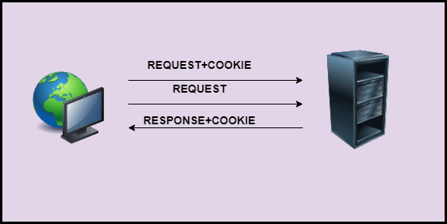
What are cookies?
Cookies are data packets that the computer receives, then sends back without altering it.

Slide 4
Uses of Cookie
Cookies are able to keep track of the website.
It is on the client-side.
Use to store login information of the user.

Slide 5
The Lifetime of cookie
Session Cookies: This is deleted when the current session ends.
Permanent Cookies: This is deleted as per the specified Expired date attribute

Slide 6
How to set Cookies in Servlet?
Create a cookie
Cookie cookie=new Cookie("key","value");
Set the maximum age
cookie.setMaxAge(60*60*24)
Send the cookie
response.addCookie(cookie);

Slide 7
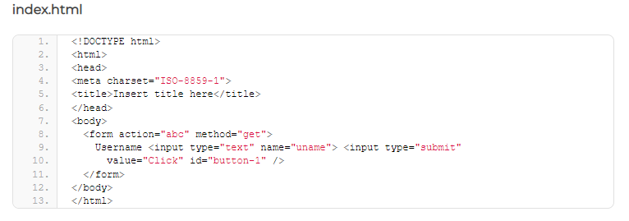
Cookies Example

Slide 8
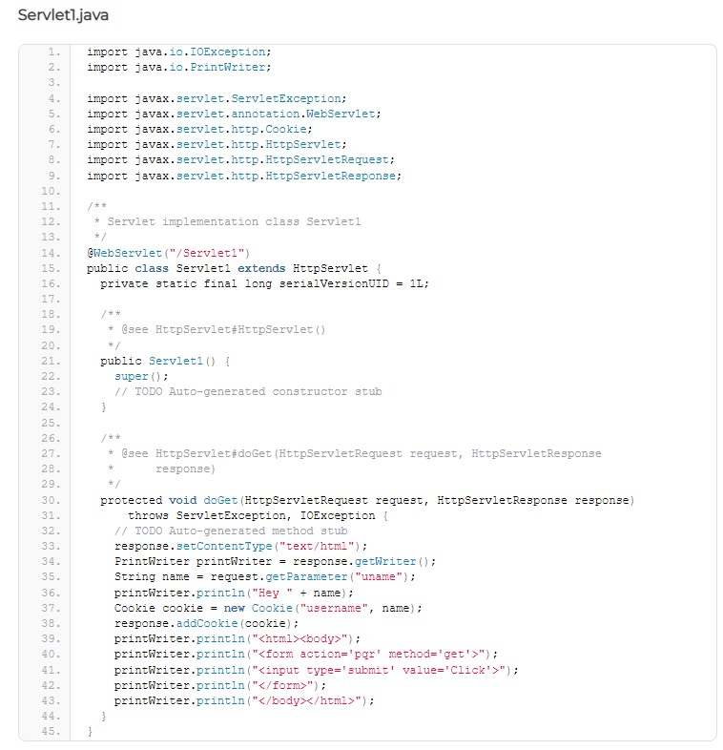

Slide 9
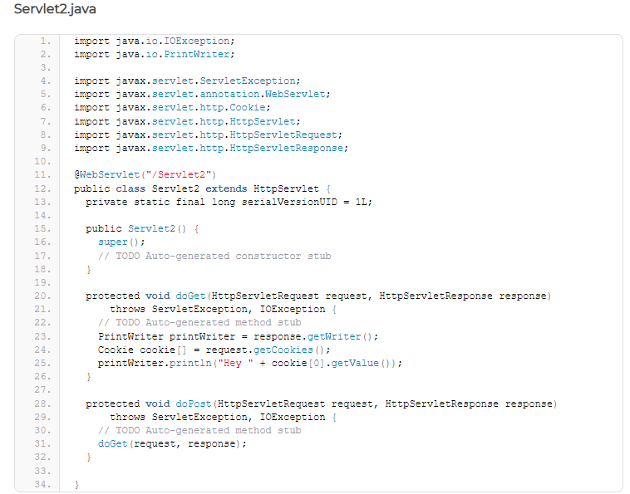

Slide 10
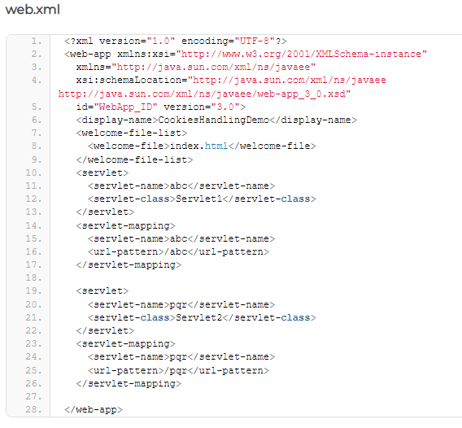

Slide 11
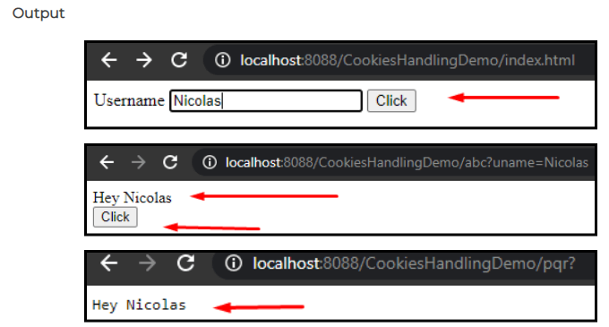

Slide 12
Servlet Filter
Filter are classes in servlet. Before the client request is processed and after its processing object of Filter is invoked. Filter as the name suggests it is used to filter tasks such as conversion, logging, validation in servlet. The Entry of the filter is defined in the web.xml file. If any changes are applied we can change in web.xml file we don’t need to change the servlet.

Slide 13
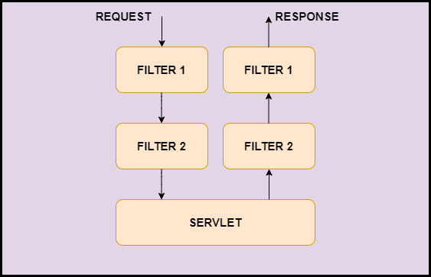

Slide 14
Why we need Filter?
Uses of Filter
A filter is used for validation.
A filter is used for encryption and decryption.
A filter is used for the recording of the incoming requests.
A filter class can be used to count the number of visitors to a site.
Filter API
The javax.servlet package contains three interfaces of Filter API.
Filter
FilterChain
FilterConfig

Slide 15
Filter Interface
Filter Interface is used to create a filter. It has all the life cycle methods for the filter. The following are the methods in a filter.
public void init(): This method is used to initialize the filter. it is invoked only once.
public void doFilter(HttpServletRequest request,HttpServletResponse response): This method is used to perform filtering task. It is invoked for every request.
public void destroys(): This method is invoked when the filter is destroyed. It is also invoked only once.

Slide 16
FilterChain Interface
The next filter or any resource is invoked by the FilterChain object. It contains only one method.
public void doFilter(HttpServletRequest request,HttpServletResponse response):This method passes the control to next filter or any resource such as servlet,etc.

Slide 17
FilterConfig Interface
The web container creates the object of FilterConfig. It is used to get the configuration information from the web.xml file. The following are the methods of FilterConfig Interface.
public void init(FilterConfig config): This method is used to initialize the filter. It is invoked only once.
public String getInitParameter(String parameterName): This method returns the parameter value for the specified parameter name.
public Enumeration getInitParameterNames():This method returns all the parameter names.
public ServletContext getServletContext():This method returns the ServletContext object.

Slide 18
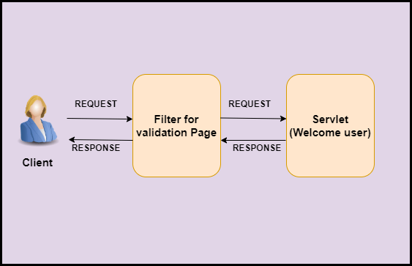

Slide 19
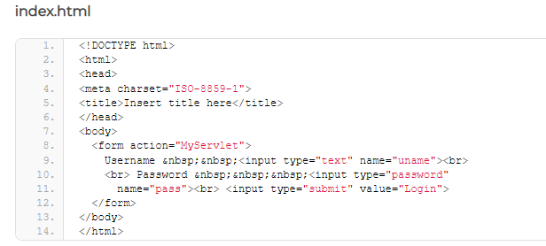

Slide 20
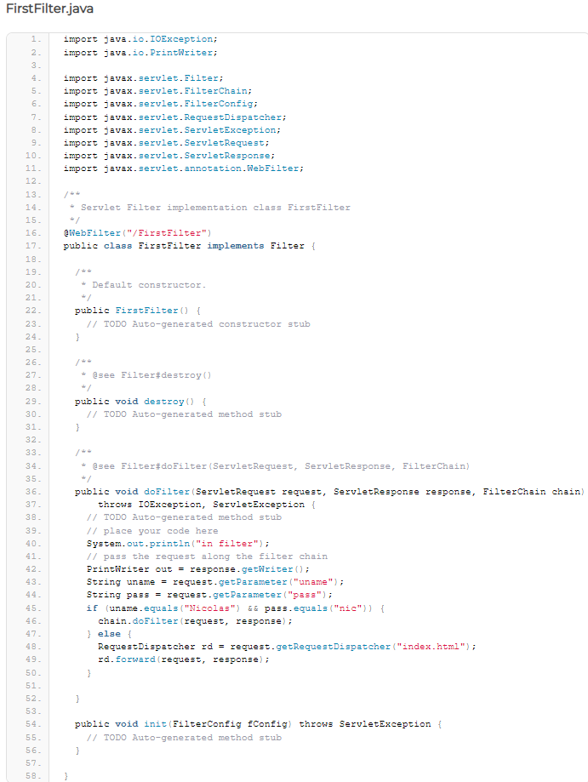

Slide 21
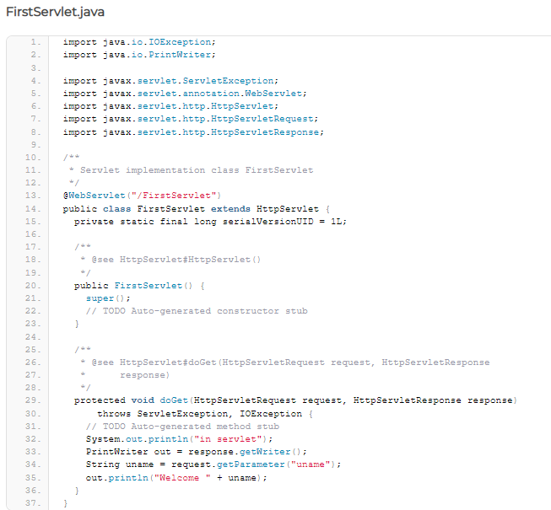

Slide 22
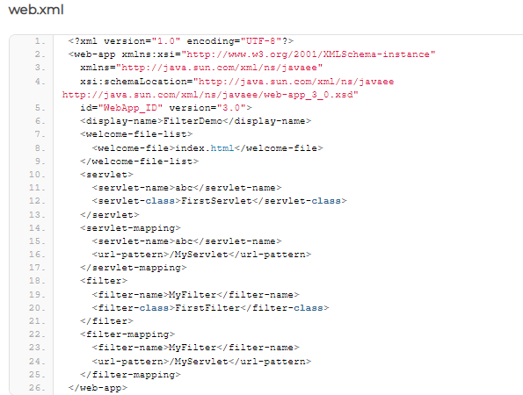

Slide 23
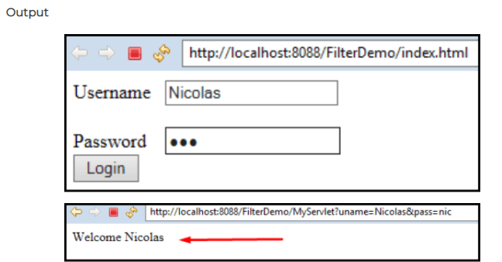

Slide 24
Advantages of Filter in Servlet
The filter analyses the user request before the servlet is called.
The filer can give an altered response.
The filter is pluggable.
The filter can help in interacting with external resources.

Slide 25
Servlet Listeners
Servlet Filter is used for monitoring request and response from client to the servlet, or to modify the request and response, or to audit and log.
Servlet Listener is used for listening to events in a web containers, such as when you create a session, or place an attribute in an session or if you passivate and activate in another container, to subscribe to these events you can configure listener in web.xml, for example HttpSessionListener.

Slide 26
What is the difference between servlet listener and filter?
Filter is just like a water filter, where incoming (request) and outgoing (response) values will be filtered.
Listener is like listening (trigger) - whenever required, I will be performed.

Slide 27
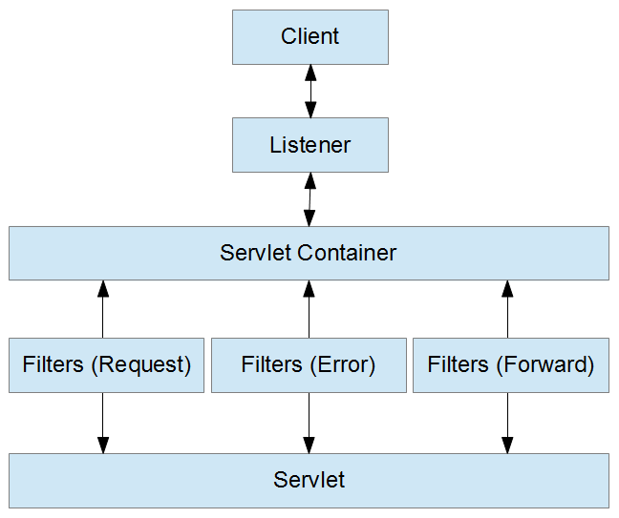

Slide 28
Problem with servlet
One servlet is loaded into JVM. It does matter numbers of requests.
When there is a request, there is a thread, not a process.
Servlet is persistent until it destroys.
Designing in a servlet is difficult and slows down the application.
You need a JRE(Java Runtime Environment) on the server to run servlets.
For non-java developers, servlet is not suitable as they required to have a broad knowledge of Java servlet.
HTML code is mixed up with Java code therefore, changes done in one code can affect another code.
Writing HTML code in servlet programming is very difficult. It also makes servlet looks bulky.
In servlet programming, if you want to use implicit objects, you need to write some additional code in order to access them.
Developers must take care of exception handling because servlet programming is not thread-safe by default.

Slide 29
What is Java Server Pages (JSP)?
A JSP file is a Java document used to dynamically generate a webpage using Jakarta Server Pages (JSP) functions.
It is similar to an .ASP or .PHP file, except it contains Java code instead of ActiveX or PHP.
Web servers parse JSP files and use them to generate HTML, which is sent to a user's web browser.

Slide 30
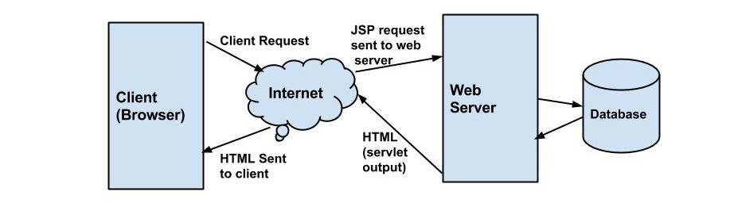
JSP architecture

Slide 31
JSP Architecture Flow
The user goes to a JSP page and makes the request via internet in user’s web browser.
The JSP request is sent to the Web Server.
Web server accepts the requested .jsp file and passes the JSP file to the JSP Servlet Engine.
If the JSP file has been called the first time then the JSP file is parsed otherwise servlet is instantiated. The next step is to generate a servlet from the JSP file. The generated servlet output is sent via the Internet form web server to users web browser.
Now in last step, HTML results are displayed on the users web browser.

Slide 32
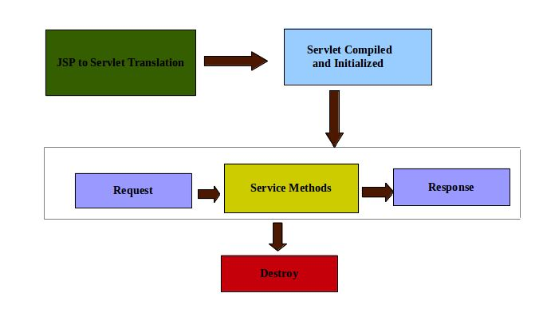
JSP Lifecycle

Slide 33
PHASE | DESCRIPTION
Translation | JSP container parses the JSP pages. It then translate the JSP pages to generate corresponding servlet source code. If JSP file name is hello.jsp, usually it is named as hello_jsp.java by the container.
Page Compilation | If the translation is successful, the generated java file is then compiled by the container.
Class Loading | Once JSP is compiled as servlet class, its lifecycle is similar to servlet. The compiled class is then loaded into the memory.
Instance Creation | Once JSP class is loaded into memory, its object is instantiated by the container.
Call jspInit() or Initialization | During this phase the JSP class is initialized transformed from a normal class to servlet. Once initialization is over, ServletConfig and ServletContext objects become accessible to JSP class. Method jspInit() is called only once in JSP lifecycle. It initializes config params.
Call _jspService or Request Processing | This method is called for each client request.
Call jspDestroy or Destroy | This is the last phase and this method is called when the container decides to unload JSP from memory.

Slide 34
JSP Scriptlet tag (Scripting elements)
In JSP, java code can be written inside the jsp page using the scriptlet tag.
JSP Scripting elements
The scripting elements provides the ability to insert java code inside the jsp. There are three types of scripting elements:
scriptlet tag: A scriptlet tag is used to execute java source code in JSP.
expression tag
declaration tag

Slide 35
File: index.html
<html>
<body>
<form action="welcome.jsp">
<input type="text" name="uname">
<input type="submit" value="go"><br/>
</form>
</body>
</html>
File: welcome.jsp
<html>
<body>
<form>
<% String name=request.getParameter("uname");
out.print("welcome "+name); %>
</form>
</body>
</html>

Slide 36
JSP expression tag
The code placed within JSP expression tag is written to the output stream of the response. So you need not write out.print() to write data. It is mainly used to print the values of variable or method.
Syntax of JSP expression tag
<%= statement %>

Slide 37
File: index.jsp
<html>
<body>
<form action="welcome.jsp">
<input type="text" name="uname"><br/>
<input type="submit" value="go">
</form>
</body>
</html>
File: welcome.jsp
<html>
<body>
<%= "Welcome "+request.getParameter("uname") %>
</body>
</html>

Slide 38
JSP declaration
The jsp directives are messages that tells the web container how to translate a JSP page into the corresponding servlet.
There are three types of directives:
page directive
include directive
taglib directive
Syntax of JSP Directive:
<%@ directive attribute="value" %>

Slide 39
Three types of directives
S.No. | Directive & Description
1 | <%@ page ... %> Defines page-dependent attributes, such as scripting language, error page, and buffering requirements.
2 | <%@ include ... %> Includes a file during the translation phase.
3 | <%@ taglib ... %> Declares a tag library, containing custom actions, used in the page

Slide 40
JSP page directive
The page directive defines attributes that apply to an entire JSP page.
Syntax of JSP page directive
<%@ page attribute="value" %>

Slide 41
S.No. | Attribute & Purpose
1 | buffer Specifies a buffering model for the output stream.
2 | autoFlush Controls the behavior of the servlet output buffer.
3 | contentType Defines the character encoding scheme.
4 | errorPage Defines the URL of another JSP that reports on Java unchecked runtime exceptions.
5 | isErrorPage Indicates if this JSP page is a URL specified by another JSP page's errorPage attribute.
6 | extends Specifies a superclass that the generated servlet must extend.
7 | import Specifies a list of packages or classes for use in the JSP as the Java import statement does for Java classes.
8 | info Defines a string that can be accessed with the servlet's getServletInfo() method.
9 | isThreadSafe Defines the threading model for the generated servlet.
10 | language Defines the programming language used in the JSP page.
11 | session Specifies whether or not the JSP page participates in HTTP sessions
12 | isELIgnored Specifies whether or not the EL expression within the JSP page will be ignored.
13 | isScriptingEnabled Determines if the scripting elements are allowed for use.

Slide 42
The include Directive
The include directive is used to include a file during the translation phase. This directive tells the container to merge the content of other external files with the current JSP during the translation phase. You may code the include directives anywhere in your JSP page.
The general usage form of this directive is as follows −
<%@ include file = "relative url" >

Slide 43
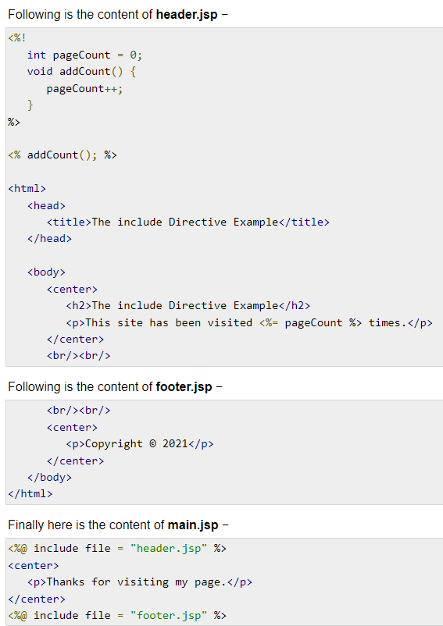

Slide 44
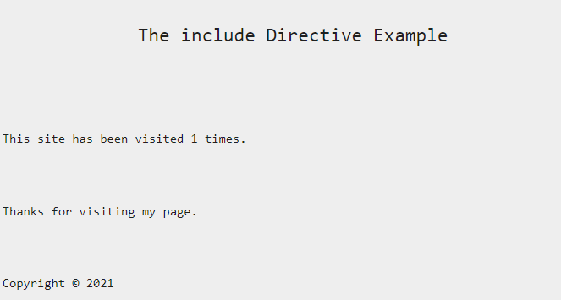

Slide 45
The taglib Directive
The JavaServer Pages API allow you to define custom JSP tags that look like HTML or XML tags and a tag library is a set of user-defined tags that implement custom behavior.
The taglib directive declares that your JSP page uses a set of custom tags, identifies the location of the library, and provides means for identifying the custom tags in your JSP page.
The taglib directive follows the syntax given below −
<%@ taglib uri="uri" prefix = "prefixOfTag" >

Slide 46
JSP - The taglib Directive Example
<%@ taglib uri = "http://www.example.com/custlib" prefix = "mytag" %>
<html>
<body>
<mytag:hello/>
</body>
</html>

